Slide 1

Intro to Unity – Interactions
By: Jeremy nIELSON

Slide 2
Basics of interaction
There is a number of interactions that you can create for the player in VR.
Weapons, bows, equipables
Physics based objects
Doors, Chests, etc.
We will be dealing with existing prefabs for the time being. More indepth interactions will be covered in the scripting tutorials

Slide 3
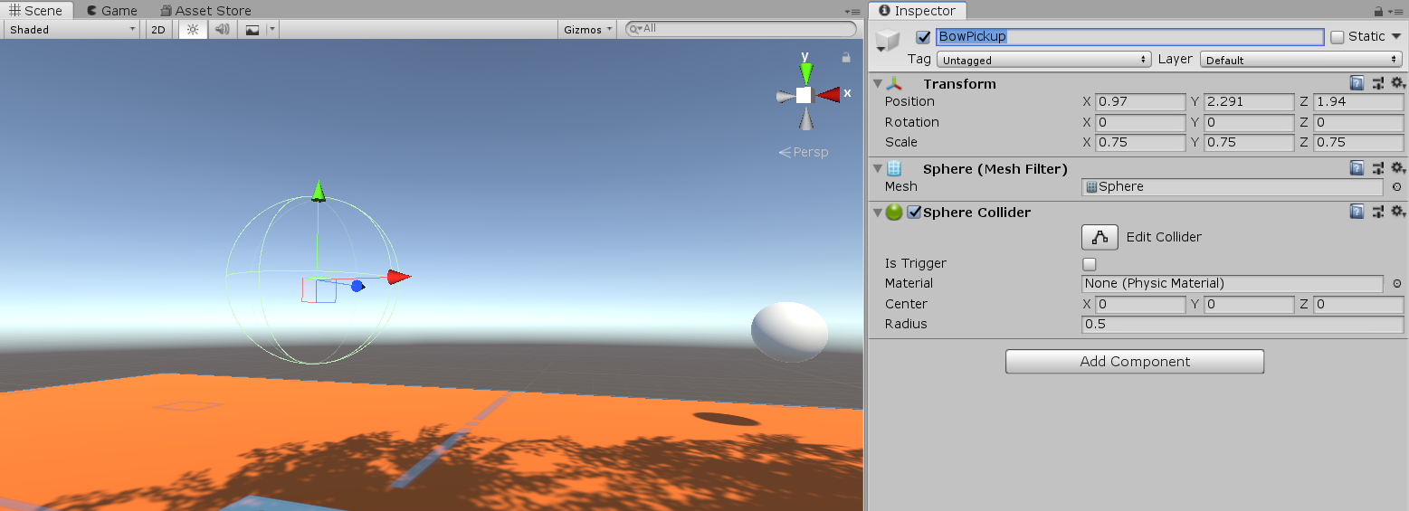
Interaction System: Bows
We will use the existing SteamVR Bow prefab and various scripts
Start by creating a 3D Object > Sphere
In the Inspector Panel, Remove the mesh renderer, and set the scale to 0.75 for X, Y, Z
Rename the sphere to “BowPickup”
The sphere will act as the trigger area for us to pick up the bow

Slide 4
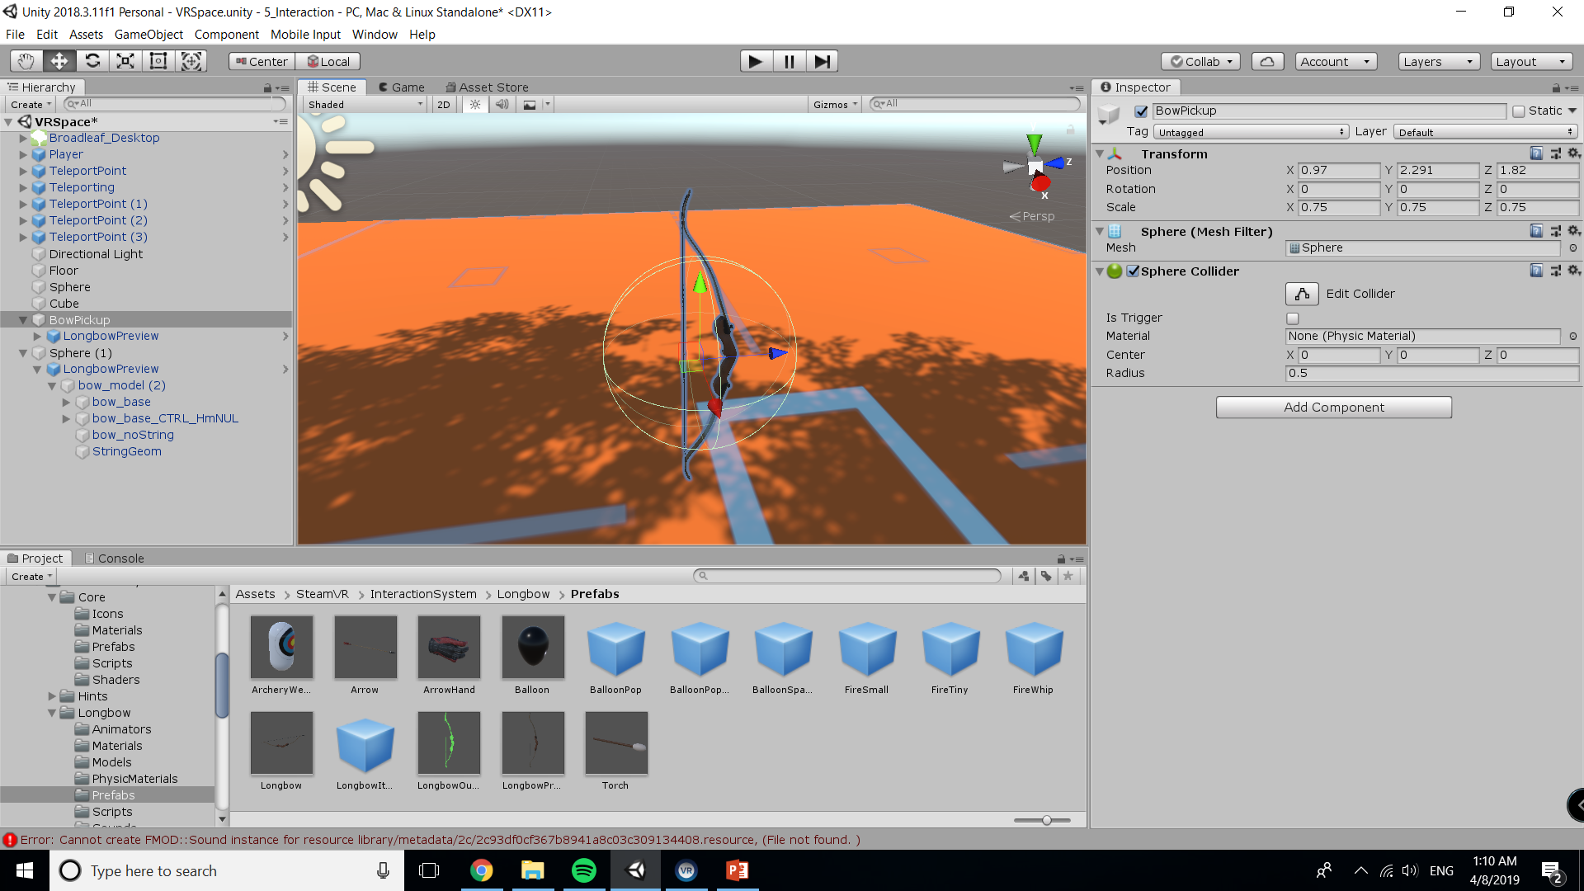
Bow Model
Grab the Longbow prefab for SteamVR.
Assets > SteamVR > InteractionSystem > Longbow > LongbowPreview
Drag and drop the Longbow into the scene
Align the bow in the center of the sphere
Use the same coordinates for position to approximate
Drag the Longbow in hierarchy onto the BowPickup

Slide 5
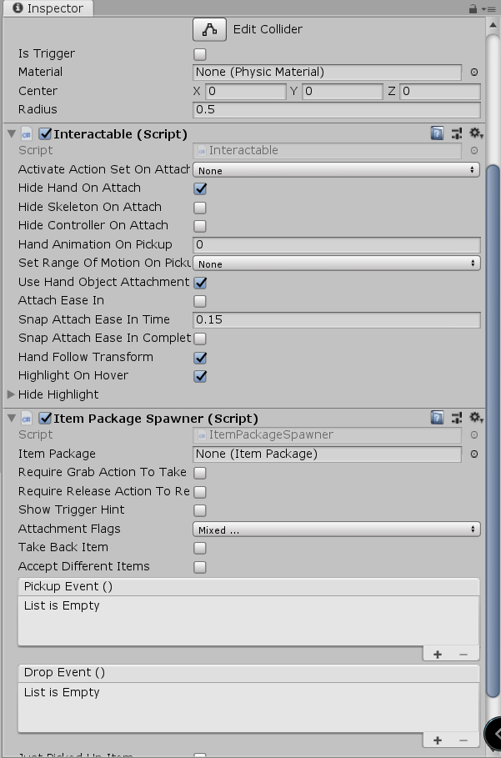
Bow functionality
Lucky for us, the scripting has been handled as well.
Select the BowPickup in Heirarchy
We will drag and drop two scripts onto the pickup, found in SteamVR > InteractionSystem > Core > Scripts
Interactable, and ItemPackageSpawner
Interactable allows the user to manipulate the object
ItemPackageSpawner allows the user to generate the specified item package and equip it

Slide 6
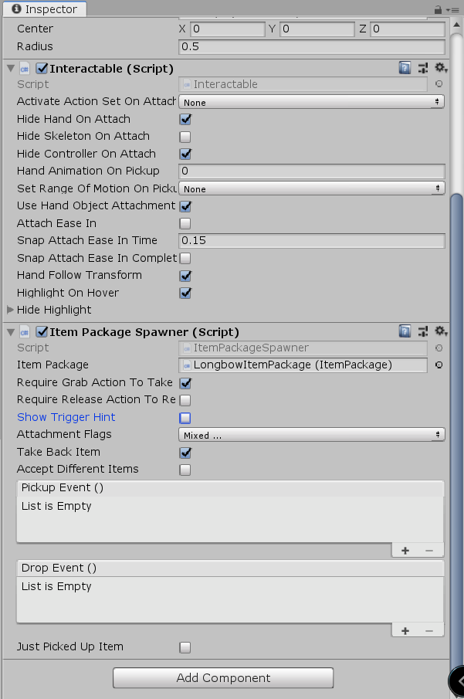
Bow Script Configuration
The Item Package Spawner requires additional configuration.
Enable Grab Action To Take
Enable Take Back Item
Attach Item Package
This is found under Longbow (LongbowItemPackage)
You can enable trigger hint to see which button grabs it, but by default the control is the grip buttons
Additionally, you can hide the controller on pickup under Interactable

Slide 7
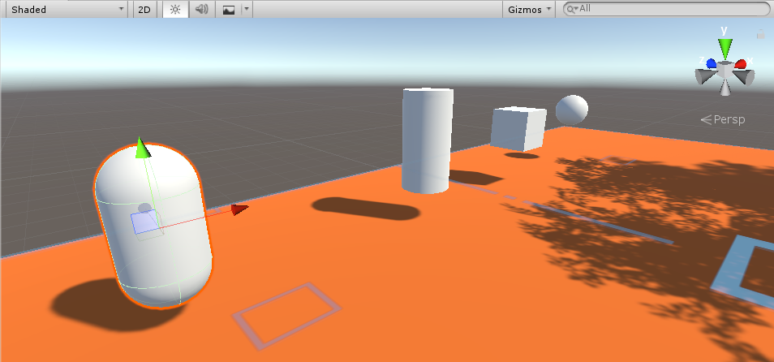
Create Physics Objects
Like in tutorial 3, we will be creating some 3D objects with Rigidbody components
Go ahead and create a cube, capsule, and cylinder in addition to the sphere
We will be creating some new materials next to give them more color

Slide 8
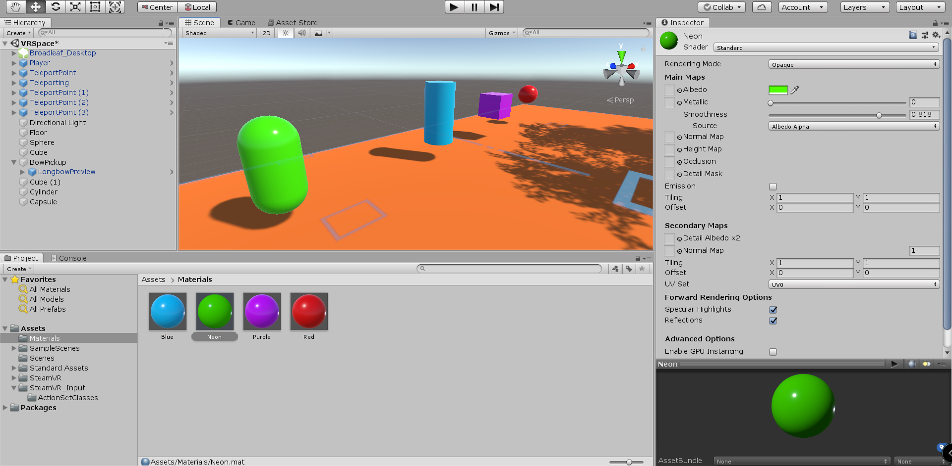
Creating Materials
Start by making a new folder in Assets called “Materials”
Inside the folder, right click and create new material
Be sure to name each one a different color
In the inspector panel, adjust the albedo (Color Picker), smoothness, and any setting you like
Drag and drop onto the objects

Slide 9
Two Final Steps
Place the bow somewhere in the level, such as on a box, the ground, or anywhere that will not be in the way
Also, for each of the rigidbody objects for testing, drag and drop the ArcheryTargetPhysMaterial to each one so the arrows will stick to them
This is under Longbow > PhysicsMaterials

Slide 10
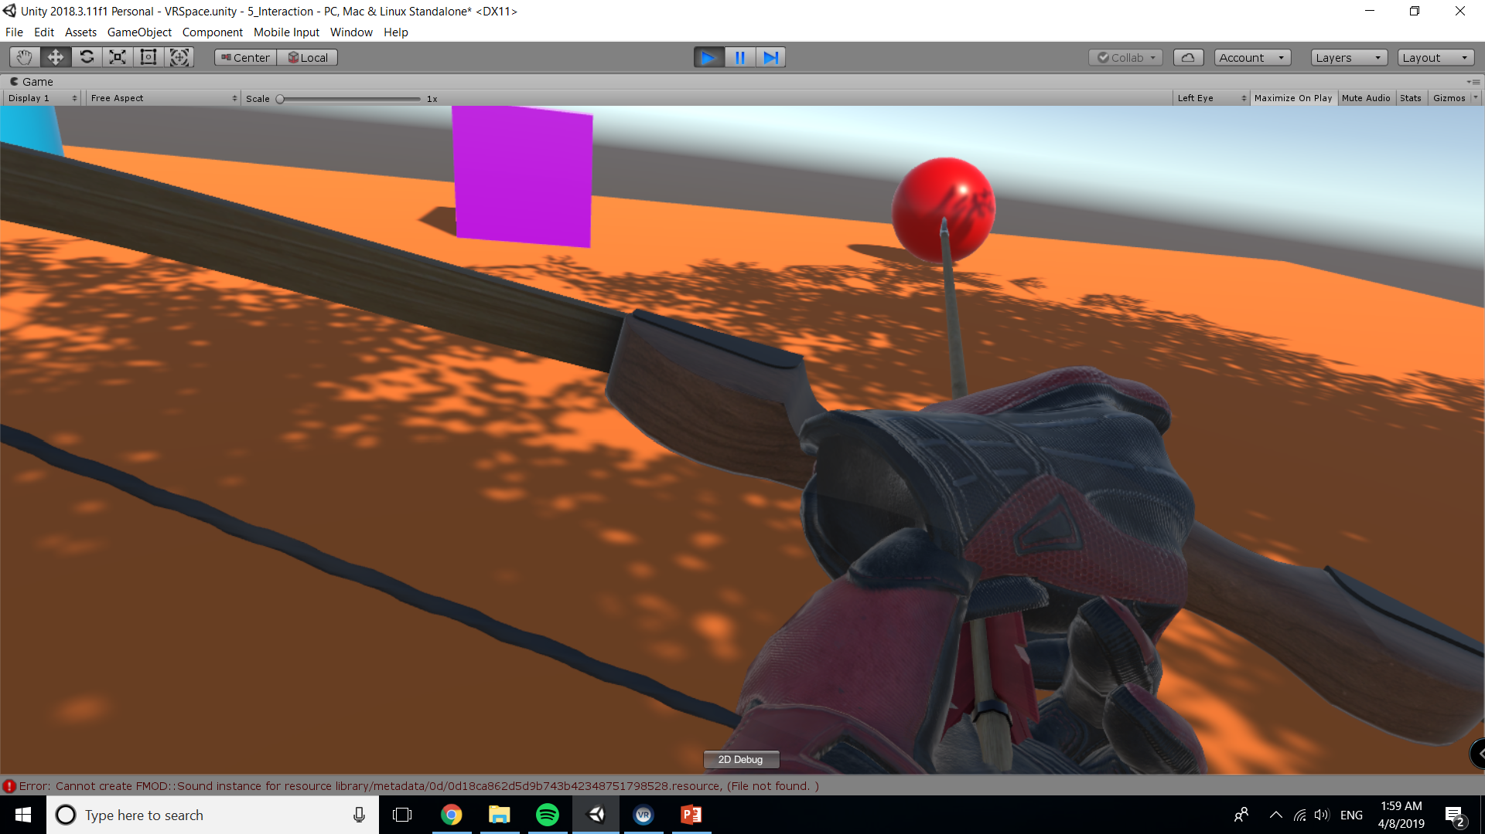
End Result

